Slide 1
Welcome to Hungary

Slide 2
We are going to talk about:
- SIM Card - TAJ Card - Grocery - Having fun in Hungary - Working - Travelling - Student Card - Banking

Slide 3
SIM Card:
You can easily purchase a SIM card from various mobile network providers like Magyar Telekom, Vodafone, and Telenor.
You'll need to provide identification, such as your passport or residence permit.
Prepaid SIM cards are widely available and can be topped up at convenience stores, online, or through mobile apps.

Slide 4
Taj Card:
TAJ Card is essential for accessing healthcare in Hungary.
Hungary has a public healthcare system; ensure you understand how it works and how to access services.

Slide 5
Grocery:
Popular grocery store chains in Hungary include Tesco, Spar, Auchan, Penny, and Lidl.
You can also shop online through websites like Tesco Online, Auchan Webshop, and others for home delivery.

Slide 6
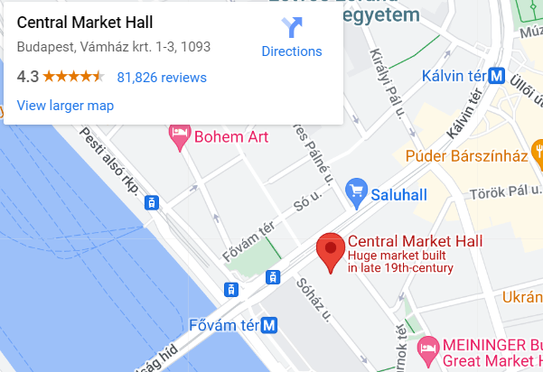
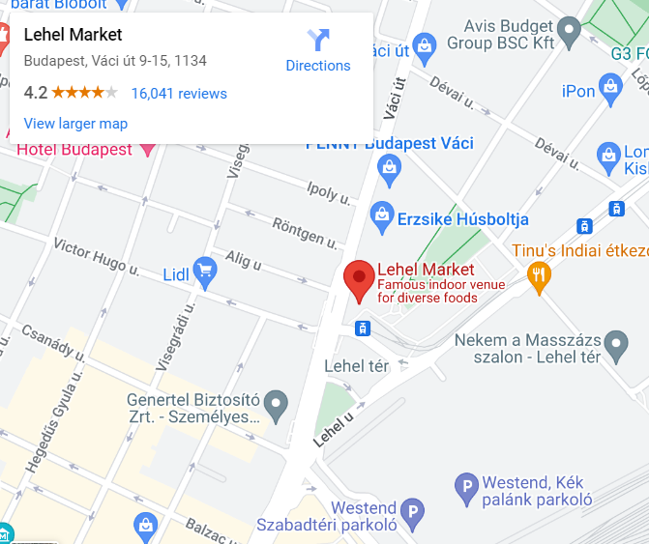
Besides that, there are good markets which are mainly located in Budapest as:
Great Market Hall
Downtown Market
Lehel Hall

Slide 7
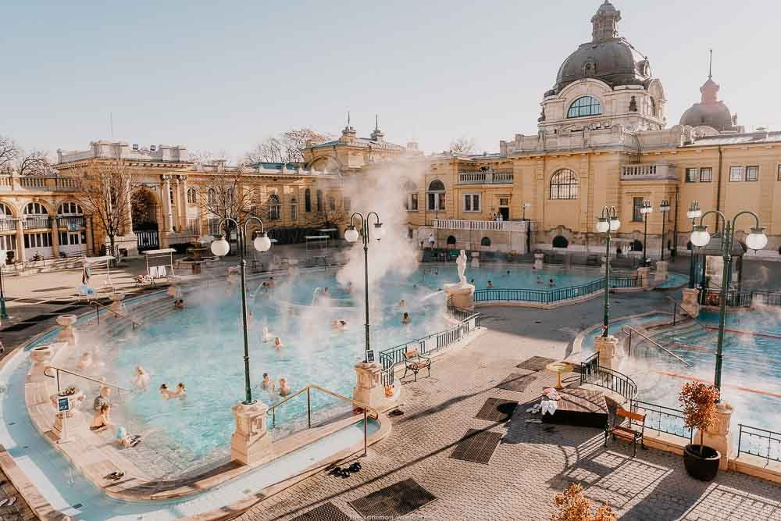
Entertainment in Hungary:
Hungary offers a wide range of entertainment options, including cinemas, theaters, zoos, and museums.
Budapest, the capital, has numerous theaters, art galleries, and museums to explore.

Slide 8
You can also join special events, concerts, and festivals.
Check Erasmus students events
Purchase tickets for special festivals, such as the Sziget Festival.

Slide 9
Working:
Look for job listings on websites like LinkedIn, Jobline, and Profession.hu.
Consider registering with a student employment agency for part-time jobs.
Networking and contacting potential employers directly can also be effective.

Slide 10
Traveling in Hungary:
For public transportation, you can buy monthly passes for various modes like MÁV (trains), HÉV (suburban trains), BKK (Budapest public transport), and Volán (intercity buses).
Reduced fare monthly passes are available for students with a valid Student ID Card.

Slide 11
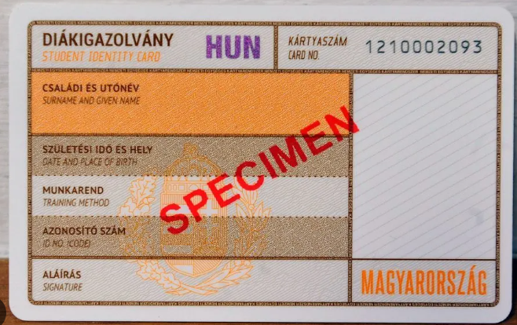
Student ID Card:
You can typically obtain a student ID card through your educational institution.
The student ID card often provides discounts for public transportation, museums, and other services.

Slide 12
Banking:
Major banks in Hungary include OTP Bank, K&H Bank, and Erste Bank.
To open a bank account, visit a local branch with your passport and residence permit.

Slide 13
Thank you for your attention
Enjoy your stay in Hungary.

