Slide 1
Hungarian University of Agriculture and
Life Sciences

Slide 2
Greeting
Graduate’s Testimonial:
Tawani Naude (from South-Africa)- SH scholar:
https://www.youtube.com/watch?v=Vdg-MuKg_EA&t=2s
About MATE: https://youtu.be/RduGnNN20eE

Slide 3
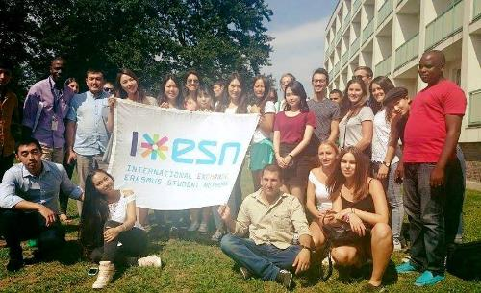
WHY MATE?
MATE brochure: https://en.uni-mate.hu/brochure-for-prospective-students
International environment: 1.816 international students from over 100 countries (~14%)
Colourful student life:
Orientation week programmes - https://youtu.be/kNZH6ZyPNDY
International dinner - https://www.youtube.com/watch?v=7yeB6zKuL14 , https://www.youtube.com/watch?v=N5kvmtHJkqg
Culture days - https://youtu.be/8GCNNT3jl08
SZIA Agroecological Garden
Campus tours
Talking clubs: Kolping Colours, 'English Corner'
MyHungary video contest

Slide 4
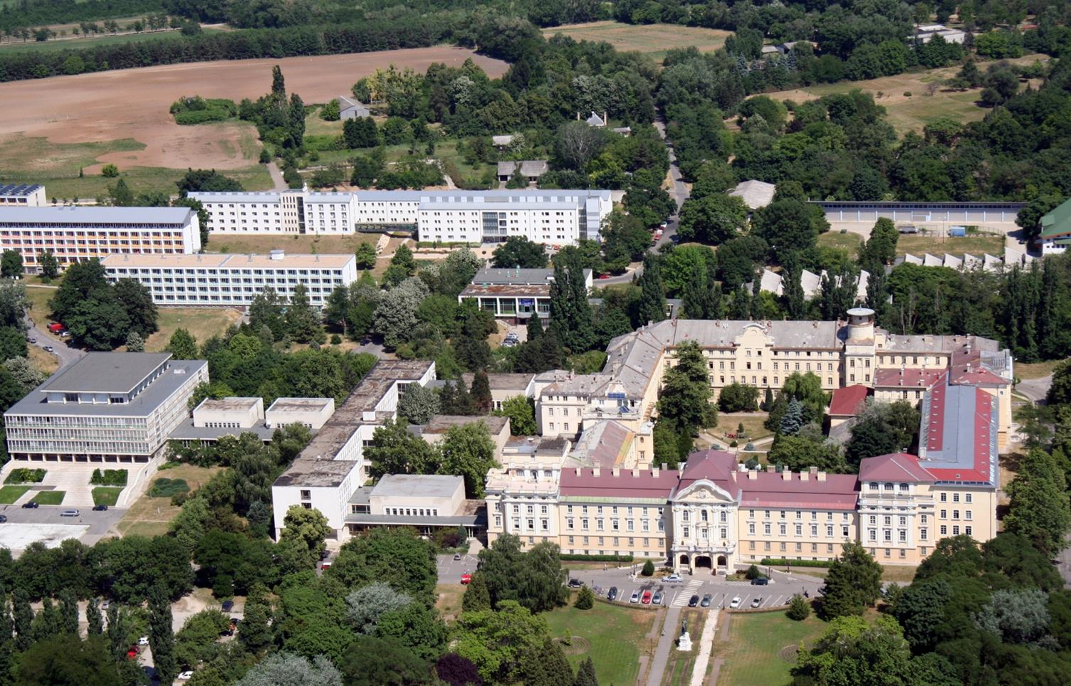
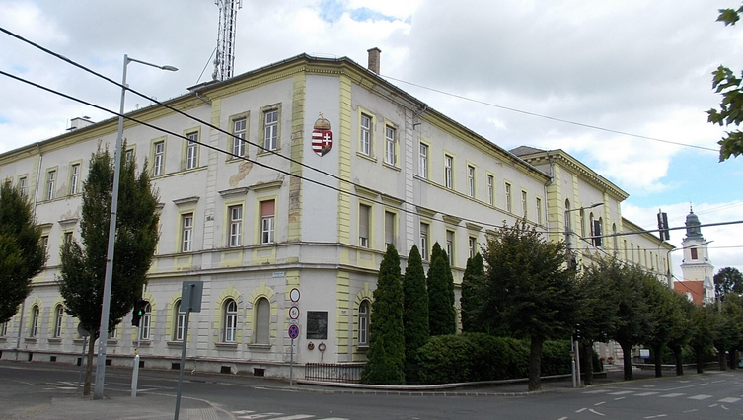
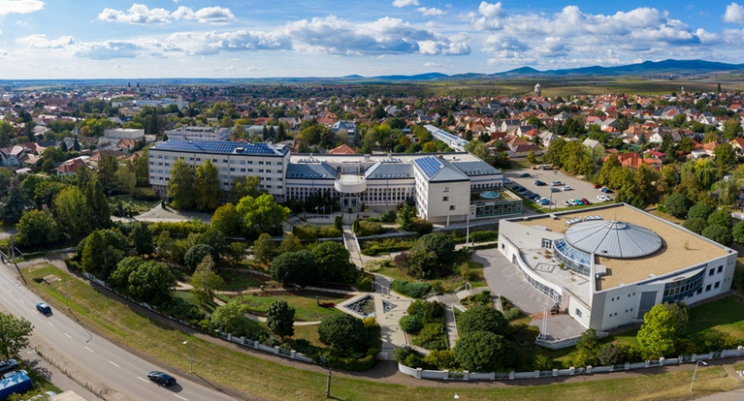
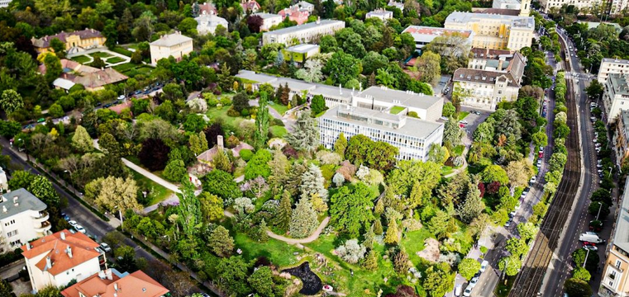
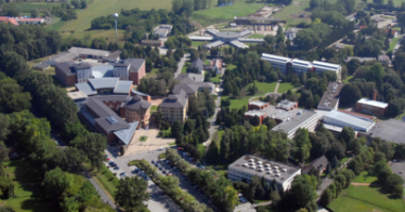
WHY MATE? - 2
Accommodation in dormitory – 1st year scholars: priority (application by beginning of August), self-financed students: in Gyöngyös Campus
Student services – mentoring systems, administrative issues, insurance, student counselling or mental health and career
Safe and green environment in all campuses:

Slide 5
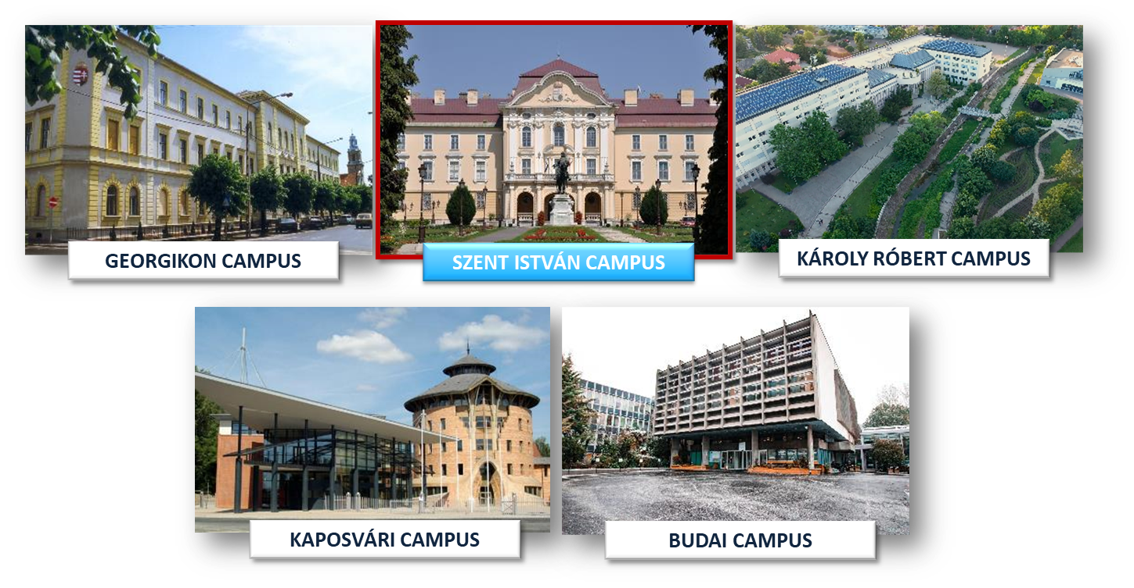
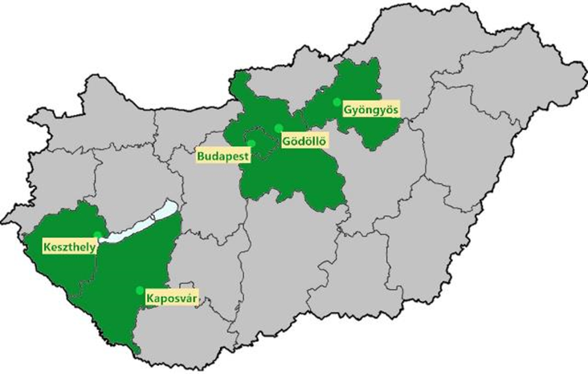
Campuses

Slide 6
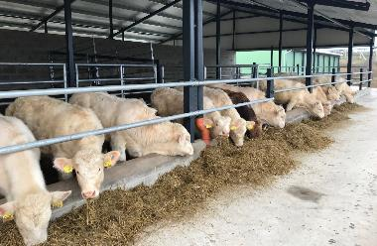
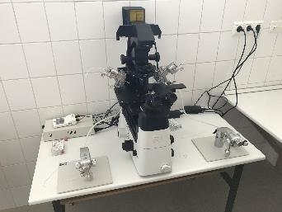
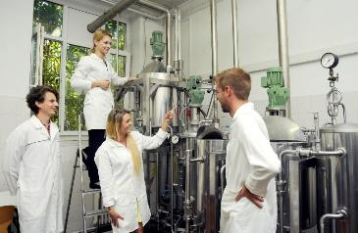
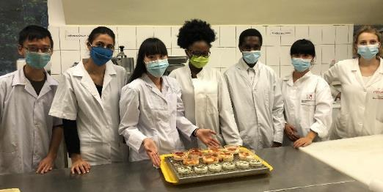
Courses in English Language I.
Bachelor Programmes (~7 semesters):
Agricultural Engineering
Environmental Engineering
Horticultural Engineering
Wildlife Management Engineering
Business Administration and Management
Mechanical Engineering
Tourism and Catering (8 semesters)
Food Engineering
Landscape Management and Garden Construction Engineering
Film and Media (6 semesters)
Curricula to check here: https://ed.uni-mate.hu/academic-year-202425

Slide 7
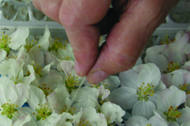
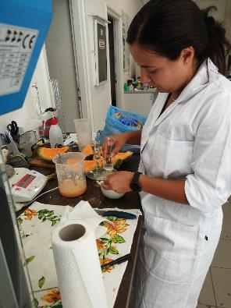
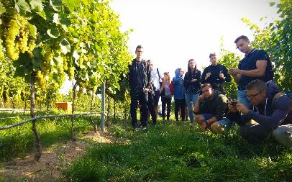
Courses in English Language II.
Master's Programmes (4 semesters):
Mechanical Engineering
Engineering Management
Biosystems Engineering (3 semesters! - NEW)
Environmental Engineering
Ecotoxicology (NEW)
Agricultural Water Management Engineering
Crop Production Engineering
Agricultural Biotechnology (Plant and Animal)
Wildlife Management Engineering
Rural Development Engineering
Management and Leadership
Supply Chain Management
Tourism Management
Business Development
Horticultural Engineering
Food Science and Technology Engineering
Food Safety and Quality Engineering
Landscape Architecture and Garden Design
Viticulture and Oenology Engineering (NEW)
Plant Protection
Business Development
Animal Nutrition and Feed Safety
Photography

Slide 8
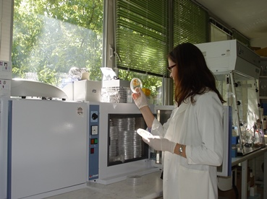
Doctoral Schools at MATE
Gödöllő Campus:
Doctoral School of Animal Biotechnology and Animal Science
Doctoral School of Biological Sciences
Doctoral School of Environmental Sciences
Doctoral School of Plant Sciences
Doctoral School of Economic and Regional Sciences
Doctoral School of Mechanical Engineering
Buda Campus:
Doctoral School of Landscape Architecture and Landscape Ecology
Doctoral School of Food Sciences
Doctoral School of Horticultural Sciences
Kaposvár Campus:
Doctoral School of Animal Science
Doctoral School of Economic and Regional Sciences
Georgikon Campus:
Festetics Doctoral School
Doctoral schools: https://en.uni-mate.hu/doctoral-schools, study period: 8 semesters (4 years)

Slide 9
Stipendium Hungaricum II.
Required documents (BSc/MSc/PhD):
Online application form (! personal data ! – SPELLING!)
Motivation letter (1 or 2?) - Why are you a suitable candidate?, letter format
Secondary school certificate / Bachelor degree / Master degree (MD)
Transcript of records (! in case of ongoing studies)
Proof of English language proficiency (B2 level) - (MD)
Passport (MD)
PhD: research proposal, 2 recommendation letters, Statement of the Supervisor (by 15 March - 3 PhD schools!)
Portfolio: Landscape Architecture and Garden Design Film and Media, Photography: Applicants can attach material in any format as part of their portfolio, be it a short film, a photo series, video, PDF summary or anything that adds value and represents the level of the artist. The point is to gain insight into his/her art.
Medical certificate (only for nominated applicants) - by 15 April
MD= missing documents (deadline: 1 August, BUT better before the entrance exam)​

Slide 10
Stipendium Hungaricum II.
Selection process:
STEP 1 – nomination (criteria differ from one country to another): complete application package is the best (middle of Jan – end of Feb) - MISP!
STEP 2 – entrance exam (middle of March – end of May)
STEP 3 – final decision (end of June) by the Board of Trustees of Tempus Public Foundation (importance of priorities: 1st choice study programme matters!)
Factors considered: your ranking position on the list of nominees + result of entrance exam (0-100 scale) + quotas (country/study programme)
Entrance exam/interview (info and invitation via email):
BSc level: based on the assessment of the uploaded documents (if necessary, oral interview)
MSc level: credit recognition procedure (60 relevant credits) + oral interview (motivation, language skills)
PhD level: oral interview (motivation, language skills + research topic, scientific background, publications, presentations at conferences etc.)
Platform: Teams / Zoom / DreamApply recorded interview

Slide 11
Stipendium Hungaricum III.
Doctoral studies:
At MATE, 3 doctoral schools consider the Statement of the Supervisor document compulsory to be uploaded by 15 March:
Festetics Doctoral School
Doctoral School of Food Sciences
Doctoral School of Landscape Architecture and Landscape Ecology
In the lack of this document, your application will be formally rejected, no entrance exam either.
For research topics and potential supervisors, please check this webpage: https://doktori.hu/index.php?menuid=115&lang=EN (official website of all doctoral schools in Hungary) Select a topic (check the last few years as well), and contact the professor directly.
You can also contact the scientific secretary or the international coordinator of the respective doctoral school: https://en.uni-mate.hu/doctoral-schools.

Slide 12
Scholarship for Christian Young People (SCYP)
Call for Application and Annexes
Application Timeline:
10 January: deadline for submitting applications
15 February: technical check
30 April: deadline for submitting medical certificate
from 15th June: decision by Minister responsible for Higher Education
from 1 July: notification about selection result
accept offer online ☺
31 July: upload missing documents
July-August: visa application process
1 September: arrival in Hungary
Approved recommendation to upload to your application:
Recommendation of the local Christian Church, following the formal criteria given in the Call for Application

Slide 13
Self-financing
Application Process
To successfully apply for study programs at MATE complete the following steps:
APPLICATION FORM
Letter of motivation
Reference forms/recommendation letters from two referees
BSc applicants: secondary school final examination
MSc applicants: BSc degree certificate and transcripts.
Proof of B2 level of English
Curriculum Vitae
Medical certificate
Payment Confirmation of 100 EUR Application Fee/application. Maximum 3 applications per applicant
Deadline: 31 May 2025
Selection Process - After submitting the Application Package
Revision of
Application
Interview
PLoA
Tuition
Fee (1 year!)
LoA
Welcome Info
Arrival
From 1 September
Detailed info: https://en.uni-mate.hu/en/application-procedure-for-bsc-msc

Slide 14
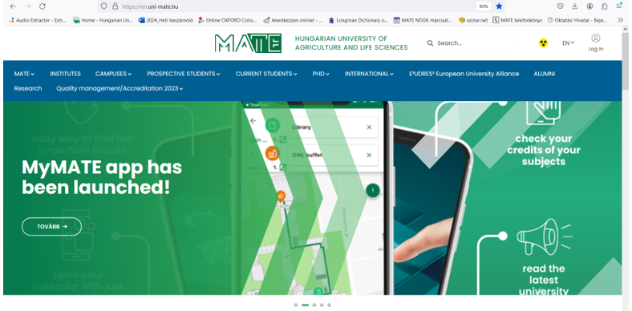
Q & A
MATE website: https://en.uni-mate.hu/ (alumni network, career services, mental health, academic calendar)
MATE brochure: https://en.uni-mate.hu/brochure-for-prospective-students
MyMATE app for MATE students: https://en.uni-mate.hu/en/h%C3%ADr/-/content-viewer/mymate-app-has-been-launched-/20123

Slide 15
Q & A II.
Language certificate requirements: B2 level of English is required (i.e. TOEFL min. of 500 on PBT, 61 on iBT; a 6.0 on IELTS, EUROEXAM or equivalent accredited language exams, including completion of previous level of studies in English e.g. GCSE or BSc) - Please, note that we do not accept DUOLINGO (DET) or EF SET test as a proof of English proficiency
Acceptable language certificates: https://en.uni-mate.hu/application-procedure-for- bsc-msc
Refund policy in case of visa rejection
Application fee (100 EUR) - 1 study programme (max. 3) - non-refundable
Family unification: neither SH nor MATE is involved in the procedure.
Financial background, health insurance and accommodation are the responsibility of the family. No accommodation can be provided in the dorm for children.
Living in Hungary / costs – 600-800 EUR/month, dormitory:120 EUR/month, cost of renting a flat in Budapest: from 250 EUR/month

Slide 16
Q & A III.
Working as a student: max. 30 hours/week
Residency after graduation
Webpage of the Immigration Office: http://oif.gov.hu/index.php?lang=en
Options:
Residence permit for job seeking and entrepreneurship
>> registration as a job seeker is necessary
Apostille procedure: https://konzinfo.mfa.gov.hu/en/legalisation-procedure-documents-be-used-abroad

Slide 17
Keep in touch!
Check our website and FB page regularly:
https://en.uni-mate.hu/
https://www.facebook.com/sziuinternational
Next virtual open day: 20th March 2025, 2 pm (CET)
Contact us:
SH – sh@uni-mate.hu
SCYP – scyp@uni-mate.hu
Self-financed – admission@uni-mate.hu

Slide 18
Thank you for your kind attention!
AZ ELŐADÁS CÍME, KÉT SORBAN
KÉSZÍTETTE: SAMPLE TAMÁS
www.en.uni-mate.hu

