Slide 1
Residence permit expiry Q&A
28th June, 2024

Slide 2
Stricter rules
NO WAY to start an extension procedure from Hungary if residence permit expired >> go home, start a new visa case
Visa is valid only for 3 months after decision-making (not from the receipt)!
NO WAY to submit an equity request after residence permit expired
Other purpose ceased to exist!
Instead: research / job-seeking / work
Family unification with study purpose res.card is only permitted for those who have done this before under the old law and family member is already unified.
Exception: a baby born in Hungary.

Slide 3
Job - seeking
valid only for max. of 9 months
cannot be converted into study purpose residence card
can be converted into a work purpose card (Employment/Hungary card/EU blue card)
registration by Munkaügyi Központ (authorities for employment);
degree - Previous level degree or a degree from home is NOT good!
accommodation (lease contract + notification of accommodation, (old address certificate)
health insurance (private for 2-3 months + savings for it)
financial background (latest 3-month bank statements, family members)

Slide 4
Studies
LoAcc. (MATE) + LoAw + NEW student status cert. from Aug 29th
academic transcript + LoExt (Tempus) + NEW student status cert. from Aug 29th
academic transcript + NEW student status cert. from Aug 29th
support letter from MATE coordinator (student status cert only later)
PhD students with NO student status, before final defense: RESEARCH purpose (research contract with the university from educational coordinator and supervisor!)

Slide 5
Work
work agreement (pre-liminary work agreement)
health insurance (TAJ will be revalidated by employer) – to bridge the gap: private insurance for 1-2 months
bank statements (savings, regular income)
accommodation documents
those who work (partly) abroad also have to have a Hungarian address to get a Hungarian work permit.

Slide 6
Application for a temporary residence cert.
2 reasons:
You
would like to leave but need a few more days (esp. PhD students).
would like to stay/extend your permit but residence permit card expires. (last 1-2 days prior to expiry/on the expiry date)

Slide 7
Application for a temporary residence cert.
Applicable for those who need to stay max. 1-2 months longer after graduation
>> list your reasons / arguments!
OIF prefers to allow +1 or 2 weeks for further administration and leaving the country after the date of the graduation ceremony
a plane ticket with the date of leaving the country
If the student is not subject to visa, there is no need to apply for a temporary residence cert. (Brazilian, Mexican students!)
List of visa-free countries: Visa exemption for entry to Hungary | Consular Information
https://konzinfo.mfa.gov.hu/en/visa-free-travel-hungary

Slide 8
Those who stay
Ideally: 45 days prior to the expiry or before BUT
…later to meet the missing document requirements in time
>>> Letter of Apology (within 45 days) = Declaration by student
Starting the extension (new issual under the new law!)
„Extension of the residence permit” – NO
We would like to inform you that a third country national who possesses a residence permit issued before 01.01. 2024 can apply for the issuance of a new residence permit under one of the legal titles of the new aliens (☺) policing law (Act XC. of 2023) based on the transitional provisions.”
„I declare that the procedure is exempt of fee.” – YES (for ministry scholarship holders) even if you are between study cycles!
🛸

Slide 9
Timing
Expiry date: last work day!
EH-start: at least 2 days before biometric data recording
Biometric data recording: 15 DAYS (not working days!!!) > this is the start of your case
Within 45 days all missing documents are to submitted otherwise your case is cancelled!
Suggested EH-start (for study purpose): July 17-19 OR August 5-9
Suggested biometric data recording: July 24-29/30/31 >> temp.res.cert. OR 2 days AFTER EH-start but August 12-16 at the latest. !29-30 >> temp.res.cert.

Slide 10
Q&A – Suggestions
When you submit your Letter of Apology, explain that your early start was hindered by the fact that you needed to travel home for your new passport and you were waiting for necessary documents and that you can meet the expected deadlines for missing documents within the procedural time.
In case you travel during summer: it is possible to come back BEFORE the expiry date AND start the procedure here. It is adviseable to postpone your longer travel home!
Coordinator’s support letter is for winning time only and it is not a substitute for your active student status certificate!
Experience: you have to upload a currently available stud. status cert. to be able to SUBMIT your documents and start your application online.

Slide 11
Q&A 2
I transferred a large sum of money to my sister last December and the money was given back to me last month. It was sent via western union. I withdrew from western union and banked the money into my account. In such a case is thjs a problem?
On July 10 I'm going Germany for an internship, so I want to know if I can complete early the all steps (like fingerprint etc) before 10th of July.
The reservation confirmation for the dormitory: I am planning to stay in Hungary, but not in a dormitory—just for a few months at my friend's flat. However, it is not possible to provide an address card.
In case your student status is over, but you still need time for finalizing your dissertation and finishing your studies with your final defense and you want to stay in Hungary.
Most probably, at the moment, you have an ongoing residence permit extension case and you are waiting for the decision of the Immigration Office.
We received the following information from the Immigration Office about the possible outcomes:
1) your application might be refused and you have to leave Hungary >> you can come back with a tourist visa (Type C for 90 days)
2) you might get a temporary residence certificate the conditions of which the applicant will be informed about in details. (Plane ticket reservation and specified date of leaving Hungary are probably necessary.)

Slide 12
Errors on IO’s EH-website
Comprehensive health insurance
Other
Based on employment
I have funds to cover the costs
I have a comprehensive health insurance

Slide 13
Errors on IO’s EH-website 2
Levels of spoken languages:
It should be A1, A2, B1, B2, C1, C2…

Slide 14
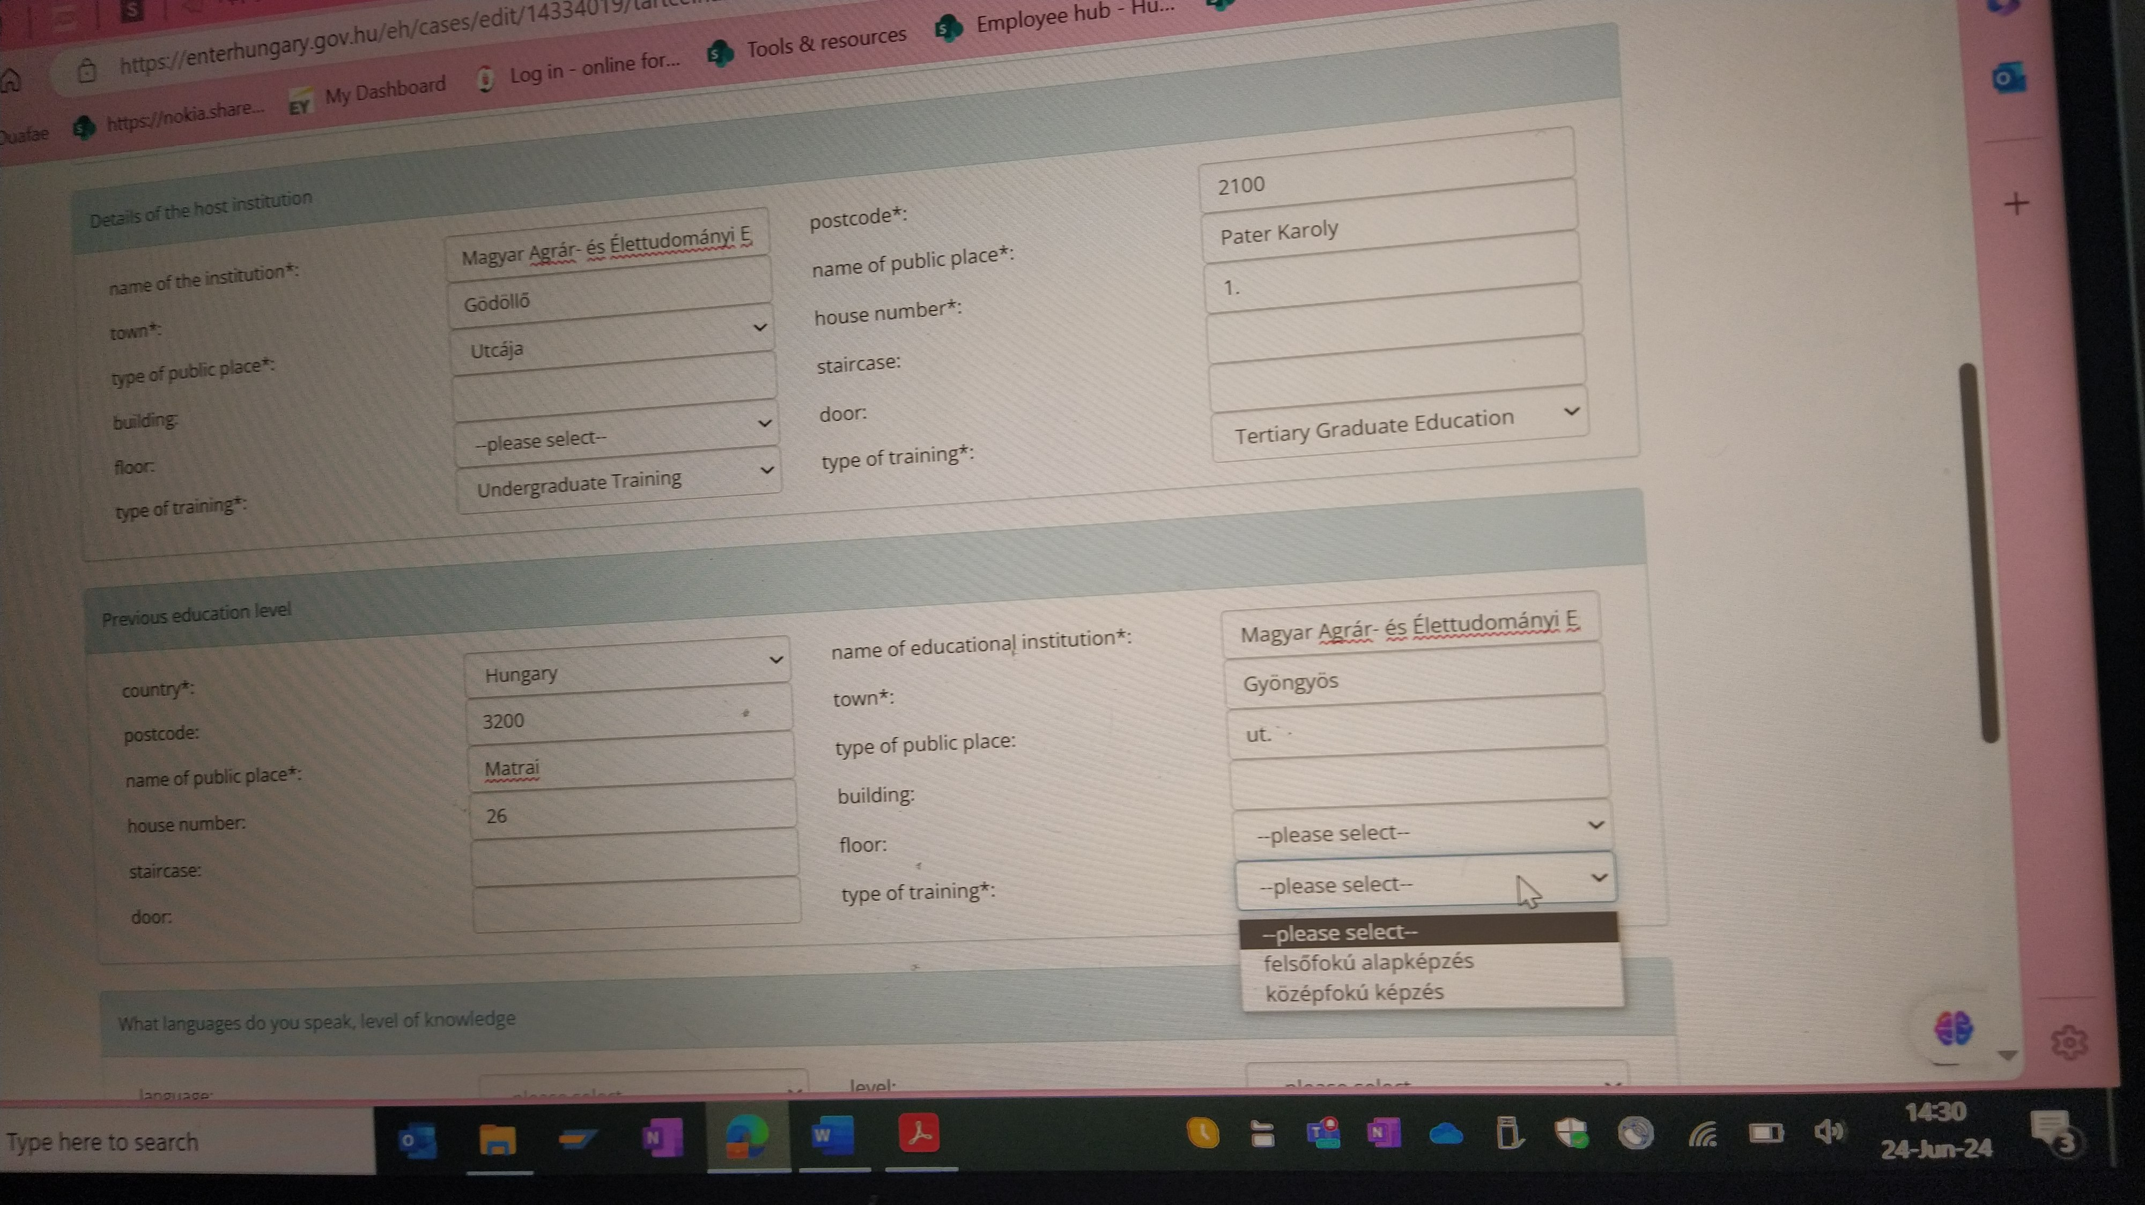
Errors on IO’s EH-website 3
Previous education level:
„Type of training” – it is a programme
„Tertiary - BSc”
„Secondary education”

Slide 15
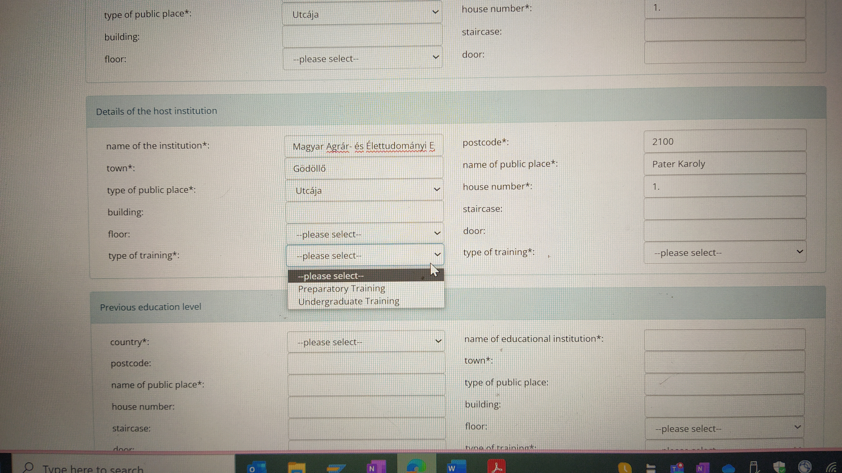
Errors on IO’s EH-website 4
Details of the host institution:

Slide 16
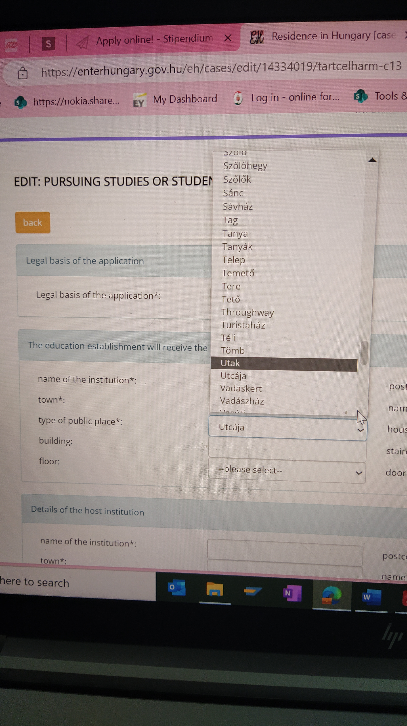
Errors on IO’s EH-website 5
Type of public place:
This should be „utca” or „út” but they are missing and cannot be typed in any way. So, choose „utcája” which is a possessive form.

